Slide 1
Experiment-3
Simulate cross correlation and autocorrelation on discrete time signals.

Slide 2
What is Correlation?
The correlation of two functions or signals or waveforms is defined as the measure of similarity between those signals. They are widely used in various applications, such as signal processing, image processing, and pattern recognition.
There are two types of correlations −
Cross-correlation
Autocorrelation

Slide 3
Cross-correlation
The cross-correlation between two different signals or functions or waveforms is defined as the measure of similarity or coherence between one signal and the time-delayed version of another signal. The cross-correlation between two different signals indicates the degree of relatedness between one signal and the time-delayed version of another signal.
There are also many applications of signal crosscorrelation in signal processing systems, especially when the signal is corrupted by another undesirable signal (noise) so that the signal estimation (detection) from a noisy signal has to be performed.

Slide 4
Autocorrelation
The autocorrelation function is defined as the measure of similarity or coherence between a signal and its time delayed version. Therefore, the autocorrelation is the correlation of a signal with itself.
Physically, signal autocorrelation indicates how the signal energy (power) is distributed within the signal, and as such is used to measure the signal power. Typical applications of signal autocorrelation are in radar, sonar, satellite, and wireless communications systems. Devices that measure signal power using signal correlation are known as signal correlators.

Slide 5
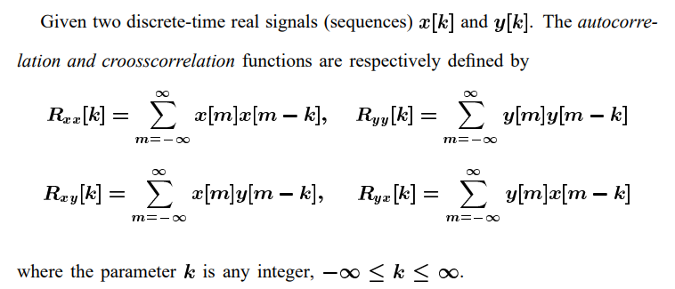

Slide 6
Flowchart/Steps
The flowchart for the program will consist of the following steps:
Define two discrete-time signals (signal 1 and signal 2) or use the same signal for autocorrelation.
Compute the cross-correlation of the two signals or the autocorrelation of a single signal.
Plot and display the cross-correlation or autocorrelation signal.
Save the cross-correlation or autocorrelation signal (optional).

Slide 7
Program
# Compute the cross-correlation
cross_corr = cross_correlation(signal1, signal2)
# Compute the autocorrelation
auto_corr = autocorrelation(signal1)
# Plot the cross-correlation and autocorrelation signals
plt.figure(figsize=(10, 6))
plt.subplot(2, 1, 1)
plt.stem(cross_corr)
plt.title('Cross-correlation')
plt.xlabel('Time Lag')
plt.ylabel('Magnitude')
plt.subplot(2, 1, 2)
plt.stem(auto_corr)
plt.title('Autocorrelation')
plt.xlabel('Time Lag')
plt.ylabel('Magnitude')
plt.tight_layout()
plt.show()
import numpy as np
import matplotlib.pyplot as plt
def cross_correlation(signal1, signal2):
# Compute the cross-correlation
cross_corr = np.correlate(signal1, signal2, mode='full')
return cross_corr
def autocorrelation(signal):
# Compute the autocorrelation
auto_corr = np.correlate(signal, signal, mode='full')
return auto_corr
# Define the discrete-time signals
signal1 = np.array([1, 2, 3, 4, 5])
signal2 = np.array([2, 4, 6, 8, 10])

Slide 8
